Slide 1

TFBS scan within TOBIAS
Anastasiia Petrova
MNI Bioinformatics

Slide 2
What we will talk about
The TOBIAS pipeline
Input, output and easy usage of TFBS scan
Using FIMO and MOODS
Customising the run of TFBS scan
Testing and results of TFBS scan
Discussion

Slide 3
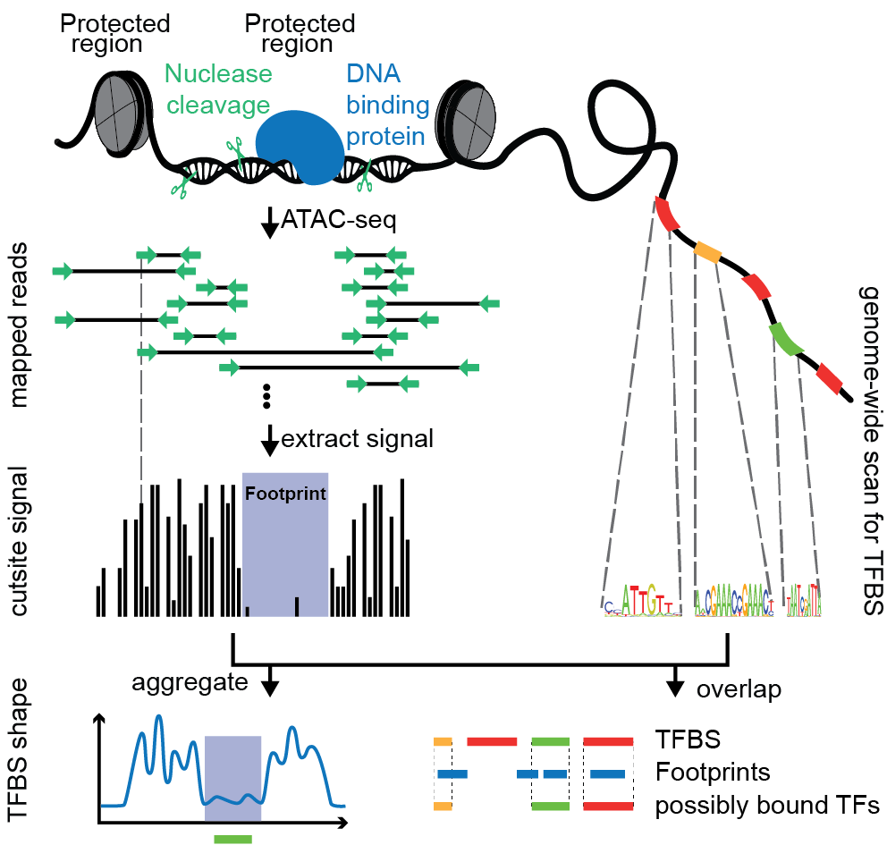
TOBIAS
Notes:
The idea of TOBIAS is:
Use the chromatin accessibility assay (ATAC-seq)
Find open chromatin regions (the signs of regulated genes)
Use footprinting to distinguish which transcription factors are bound (sign of active regulation by TF)
uantify binding overlap of footprints with motifs
Finally annotate bound transcription factors to genes (which genes are regulated by which TF in this condition)

Slide 4
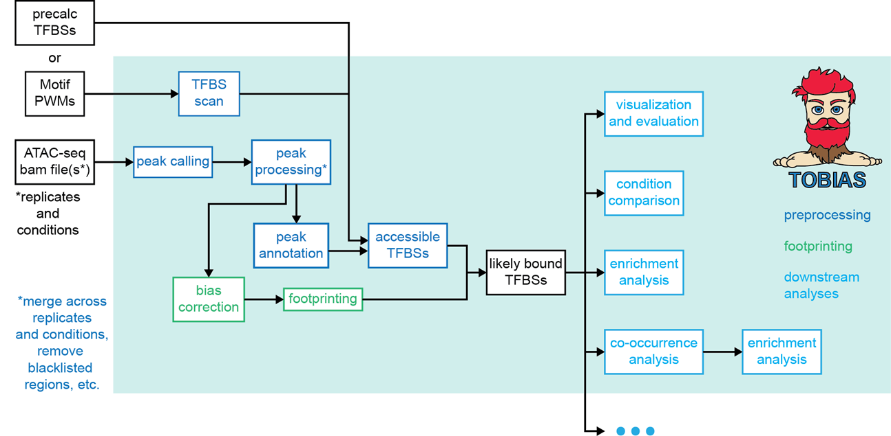
TOBIAS
Transcription factor Occupancy prediction By Investigation of ATAC-seq Signal
Notes:
My task is to ensure the TFBS scan, so that the produced data can be used to join the footprint and motif information across genome.

Slide 5
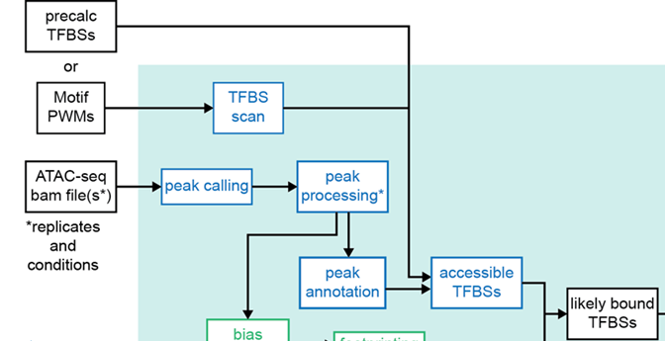
TFBS scan
Transcription
Factor
Binding
Sites
scan
Notes:
The name of the tool I make is easy to understand

Slide 6
TFBS Scan Input
a file with motifs
a genome file
a .bed file with peaks (optional)
.bed files each containing the information only for one motif
TFBS scan
Notes:
As input for my tool I receive a file with motifs, an example of which i will show in few seconds, a genome file in .fasta format and optional a .bed file with peaks, within which we want to search for the TF.
So now we want to see what a motif file looks like

Slide 7
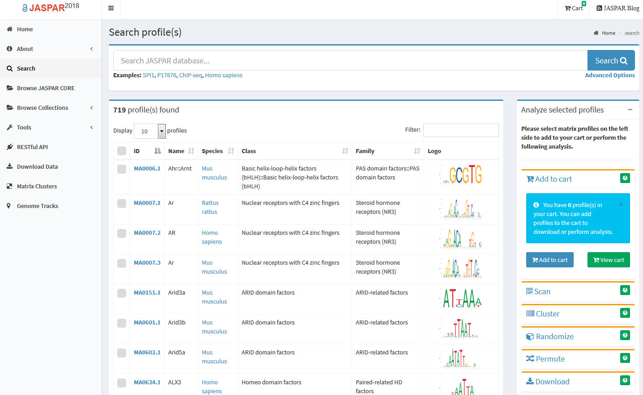
Transcription Factor
Notes:
So my task is to work with transcription factors.
Transcription factor (TF) (or sequence-specific DNA-binding factor) is a protein that controls the rate of transcription of genetic information from DNA to messenger RNA, by binding to a specific DNA sequence. The function of TFs is to regulate - turn on and off - genes in order to make sure that they are expressed in the right cell at the right time and in the right amount throughout the life of the cell and the organism.
All the transcription factors could be found in the JASPAR database available at http://jaspar.genereg.net

Slide 8
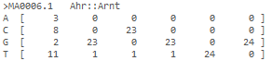
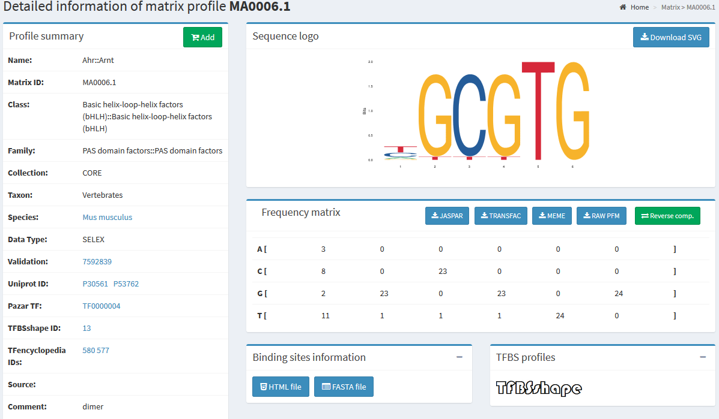
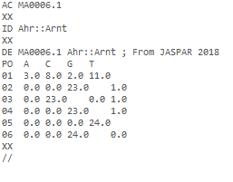
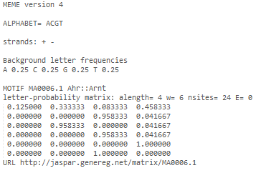
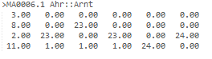
Transcription Factor
Notes:
As example we will look through the first motif listed in the previous slide. There are of course several ways to display the motifs. Here are some of them.
Of course, you can always find the name and the id in each of the formats.

Slide 9
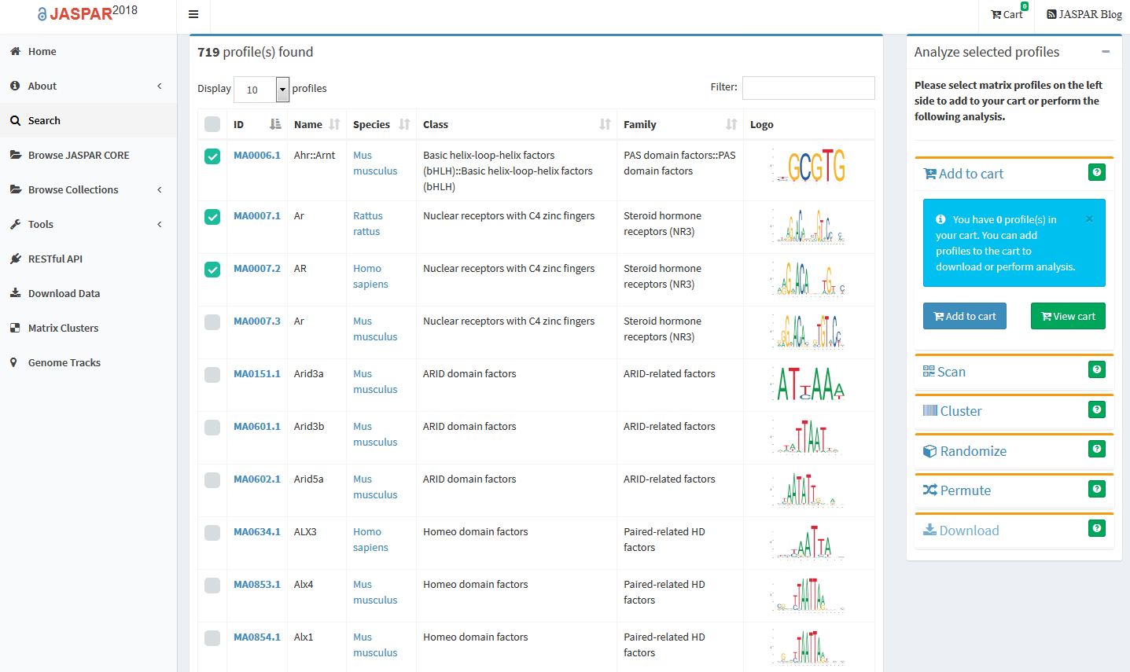
Transcription Factor
Notes:
After you have choosen several motifs you want to use, just click on download and then choose „Combined text file“ and the matrix format you need. The format one wants to use depends on the way how the TFBS scan will proceed the data. If will tell more a few moments later.
So the using of the JASPAR database is pretty easy.

Slide 10
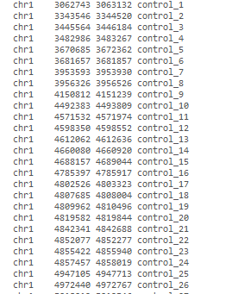
TFBS Scan Input
a file with motifs
a genome file
a .bed file with peaks (optional)
.bed files each containing the information only for one motif
TFBS scan
Notes:
I don‘t want to speak a lot about the other input files, as you of course know what the .fasta file is.
As you can imagine, the search within the whole genome will take a lot of time, that‘s why it makes sense to provide a .bed file with peaks as input also. It will make the search way faster and better as the TFBS scan will look for the needed information only within the regions you want to search in.
Peaks are the regions of interest, so called open regions in the ATACseq
A .bed file has three required columns:
The name of the chromosome (chr1, chrY)
Starting position in the chromosome
Ending position in the chromosome
The following columns are optional. They can be: the score, strand, name that defines the BED line when displayed in Genome Broswer window and so on
If the .bed file was provided, the additional information from it will be added to the output file of the TFBS scan.

Slide 11
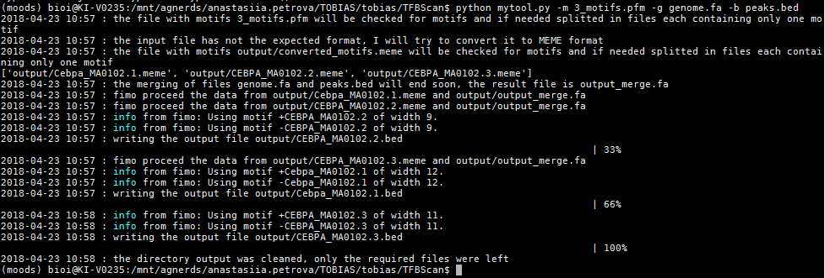
TFBS Scan Usage
https://github.molgen.mpg.de/anastasiia/TFBSscan
Notes:
First go to GitHub and clone the directory with the TFBS scan. You can follow the instructions on the GitHub to make TFBS scan work for you
To use the TFBS scan, the first thing you want to do is to activate the environment
After this, you can just call the tfbsscan.py using python and follow the instructions
As I have already mentioned, there are required input files, such as a file with motifs and a genome file and a couple of optional arguments.
The easiest way to use the TFBS scan is to say python mytool.py –m 3_motifs.pfm –g genome.fa –b peaks.bed
I will tell a bit more about all the optional arguments later, now we want to see what the output looks like.

Slide 12
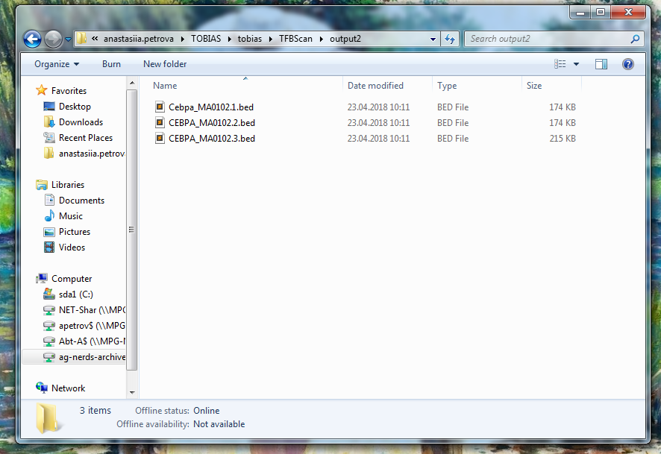
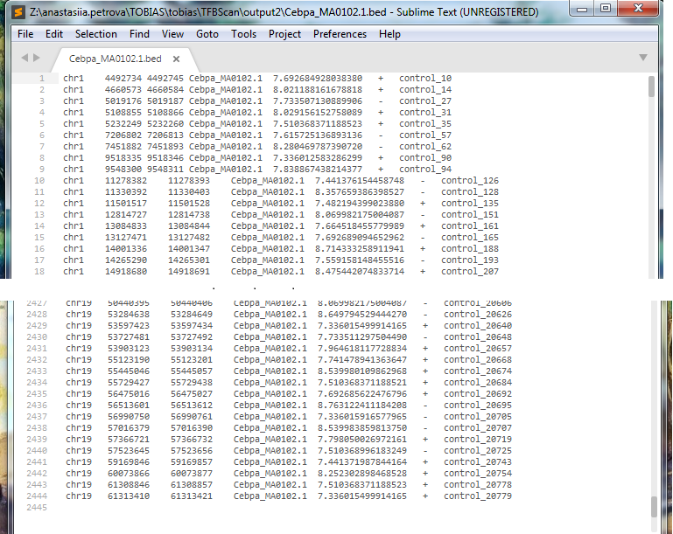
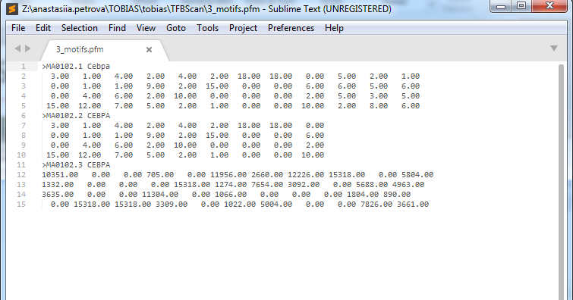
TFBS Scan Output
a file with motifs
a genome file
a .bed file with peaks (optional)
.bed files each containing the information only for one motif
TFBS scan
Notes:
As an output one receives the file in .bed format. If several motifs were given as input, user receives as many output .bed files as many motifs were given. Each of the output files will contains the information about only one motif and the file itself has the name of the motif with .bed extension.
As you can see there are also three required .bed columns and the additional information from the .bed file, that was given as input

Slide 13
TFBS Scan
Check existing input files
Check output directory (set the new one using -o output_directory as optional argument)
Split motifs (if needed, convert them MEME ←→ PFM)
Merge the peaks.bed with genome.fa using bedtools
Use multiprocessing to call one of the tools (saying --use fimo or --use moods), write the output files and clean the directory (choose --clean [all, nothing, cut_motifs, fimo_output, merge_output, moods_output])
a file with motifs
a genome file
a .bed file with peaks (optional)
.bed files each containing the information only for one motif
TFBS scan
Notes:
Now after we know what the input and what the output files are, we want also to know how it works.
The steps TFBS scan makes to work with the input data are:
Check if the input files exists, the input genome.fa will also be checked if it is in FASTA format. If an input file doesn‘t exist, the message will be shown on the terminal
If user provides an output directory name using –o output_directory as optional argument, it will be checked, if this directory exists and if not, the new directory will be created. If the directory mentioned by the user as output_directory exists already, it should contain no files which TFBS scan can consider as useful, that means no files with format of meme or pfm or bed or fasta. Otherwise the right computation cannot be provided.
If the input file consists several motifs, it will be splitted into files containing each only one motif. The TFBS scan can convert files in MEME format to the .PFM format and the other way around. All other formats are not welcome here.
If the peaks.bed file was given as input, merge the peaks.bed with genome.fa using bedtools getfasta, the output file is always called output_merge.fa and will be saved in the output directory
Use multiprocessing to count the percentage of the finished work, call one of the tools: FIMO or MOODS, write the output files and clean the directory if user wants to.
I will briefly tell you what FIMO and MOODS are, so that you can understand what is TFBS scan is doing

Slide 14
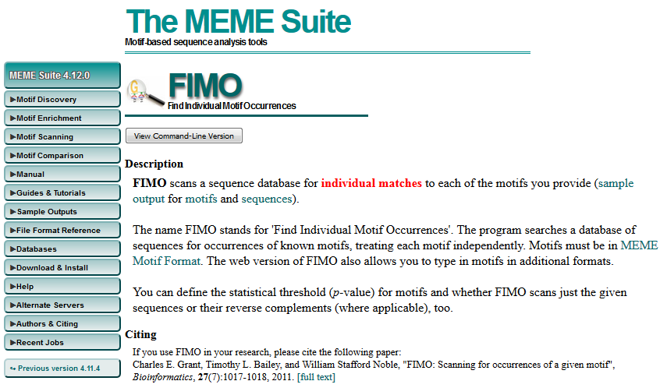
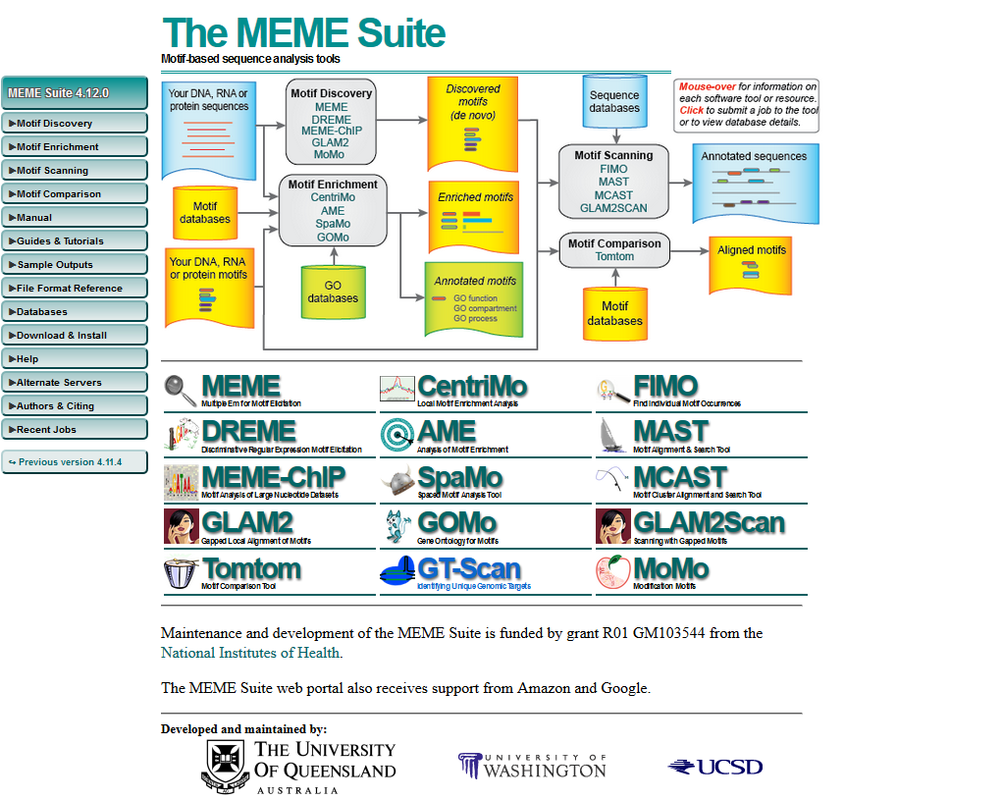
FIMO
Pass options from TFBS scan to FIMO:
-- fimo „--norc“
Usage:
fimo [options] <motifs> <dna_sequence>
Notes:
The name FIMO stands for 'Find Individual Motif Occurrences'.
The program searches a database of sequences for occurrences of known motifs, treating each motif independently.
Application of FIMO: Determining all the positions where a transcription factor (TF) motif matches in one or more promoter sequences.
FIMO takes .meme format as input and is easy to use just by calling it like fimo motif.meme sequence.fasta
User can pass several options to the fimo, but the TFBS scan need to set some parameters itself, for example, I am using -- text because otherwise fimo will write the whole new directory with files in several formats, even in .html, but we don‘t need it. The other parameter set from TFBS scan is -- no-qvalue, because within the text-mode one can‘t count the q value. And we do not need it either.
But if a user wants for example to do not score the reverse complement DNA strand, it is possible to pass the optional arguments to TFBS scan using -- fimo „--norc“

Slide 15
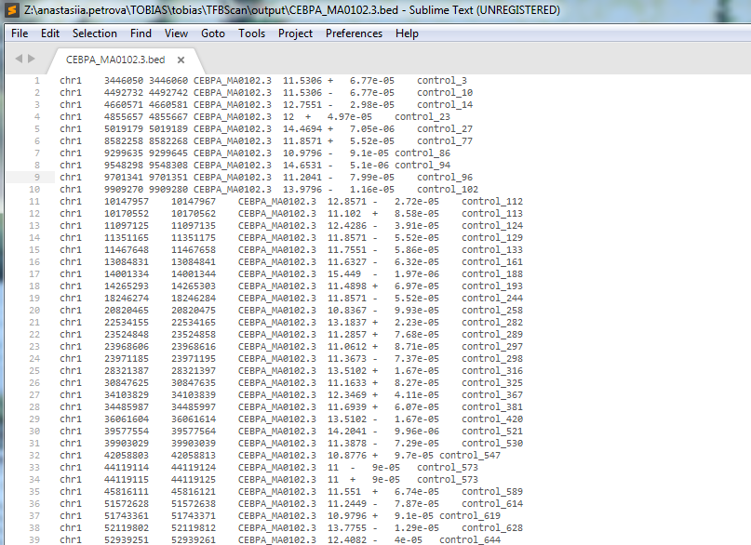
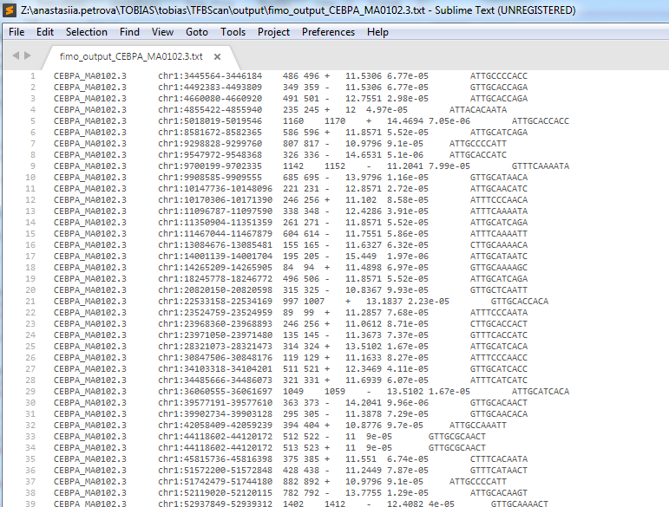
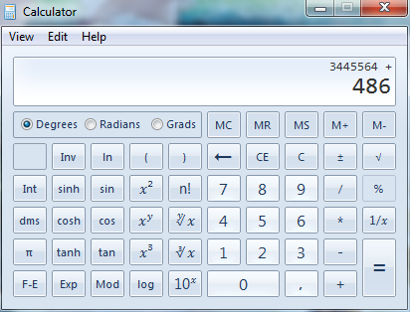
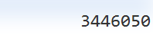
FIMO Output
Notes:
Sometimes fimo will not output the sorted file, so the TFBS scan will sort it to work with it later on.
The output file of fimo contains several columns, the first one is the name of the motif, the chromosome with positions follows it.
The positions on the chromosome in the fimo output are though not the real one, but those found within the peaks. The next two columns mean the start position and the end position of the motif within the peak. So to find the real positions on the chromosome i needed to add the 3. column to the position from from the second one.
We will first look on the other tool TFBS scan uses and than we will talk about what happens later with the output files.

Slide 16
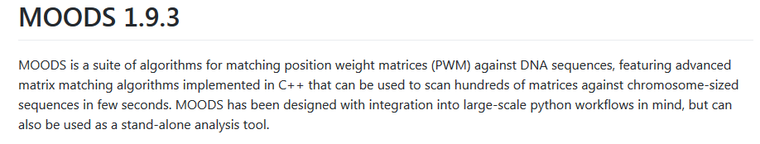
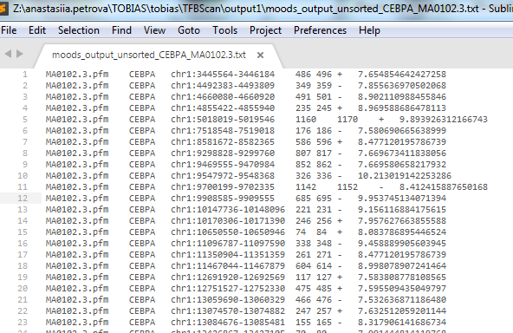
MOODS Output
Notes:
The other tool you can use within TFBS scan is MOODS.
MOODS is a package on github https://github.com/jhkorhonen/MOODS/wiki/Getting-started
There has been several problems while integrating the MOODS in my script. It was not as easy to use MOODS as it was with FIMO, as it didn't work with the current version of python, until Jens helped us and wrote on github. But afterwards I saw that MOODS was actually much quicker than FIMO, as it is implemented in C++. MOODS takes as input a .pfm file where the weights are listed.
One can use MOODS with python libraries or with the command-line tool. I could not bring the command-line tool to work, so I wrote my own script using the python libraries of MOODS. It is much shorter and is exactly as i needed it for TFBS scan. I also could adapt the output from MOODS so that it looks the same as from FIMO, to proceed them on the same way later on. First are the columns/column with name and motif_id, then are the peaks, the positions withing the peaks, strand information, score.

Slide 17
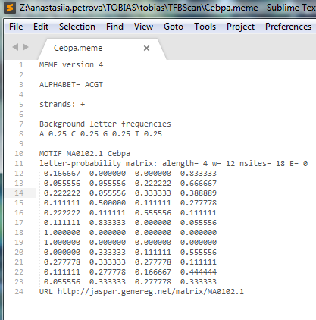
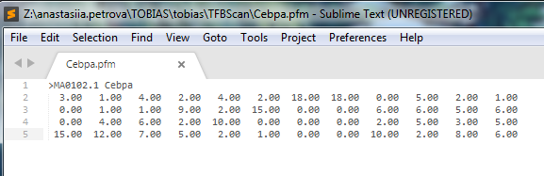
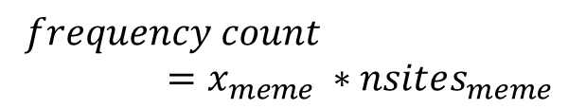
Convert Input Motifs
FIMO
motif.meme
MOODS
motif.pfm
jaspar2meme -pfm
convert_meme_to_pfm
$$frequency count=x_{meme} ∗nsites_{meme}$$
Notes:
As it could be uncomfortable for a user to convert each motif each time to try it in moods instead fimo or the other way around, i build in a function to authomaticaly convert the motif into meme format, if given in .pfm but needed to use fimo.
The convertion from pfm to meme was not hard, as MEME suite provides a tool to convert it, the only thing one should be attentive is that jaspar2meme –pfm can use only the old version of the .pfm files, that is without the first line with >motif_id motif_name. That’s why I needed to cut them before using this tool.
There is though no tool to convert meme to pfm, but using this formula, I could do it easily within my script.

Slide 18
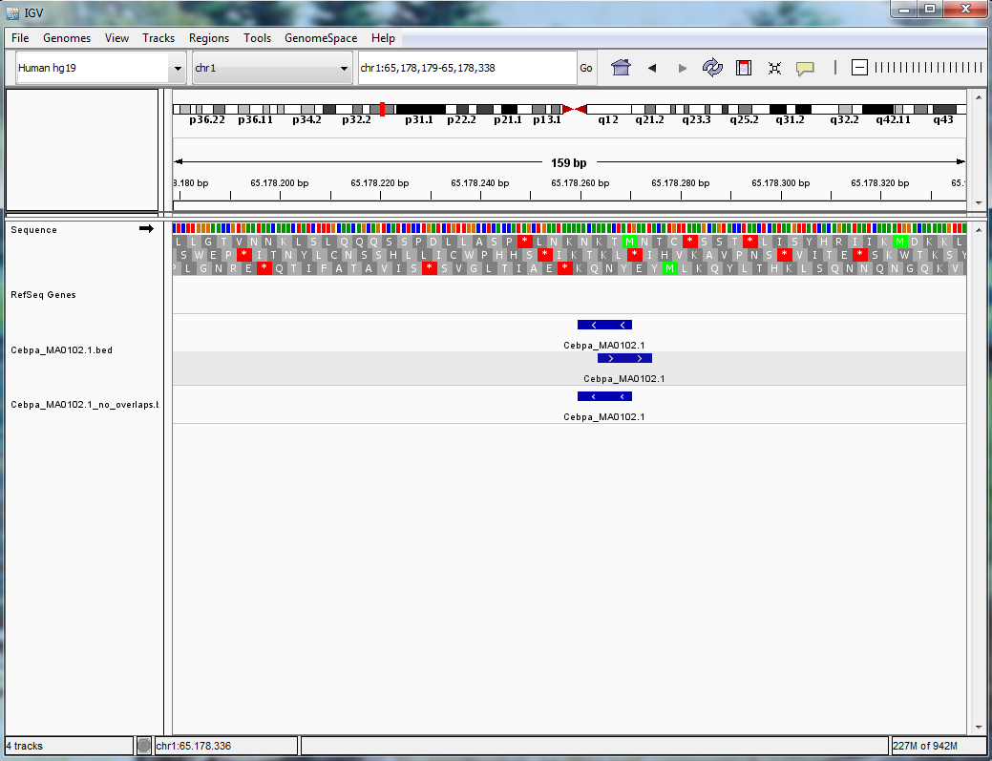
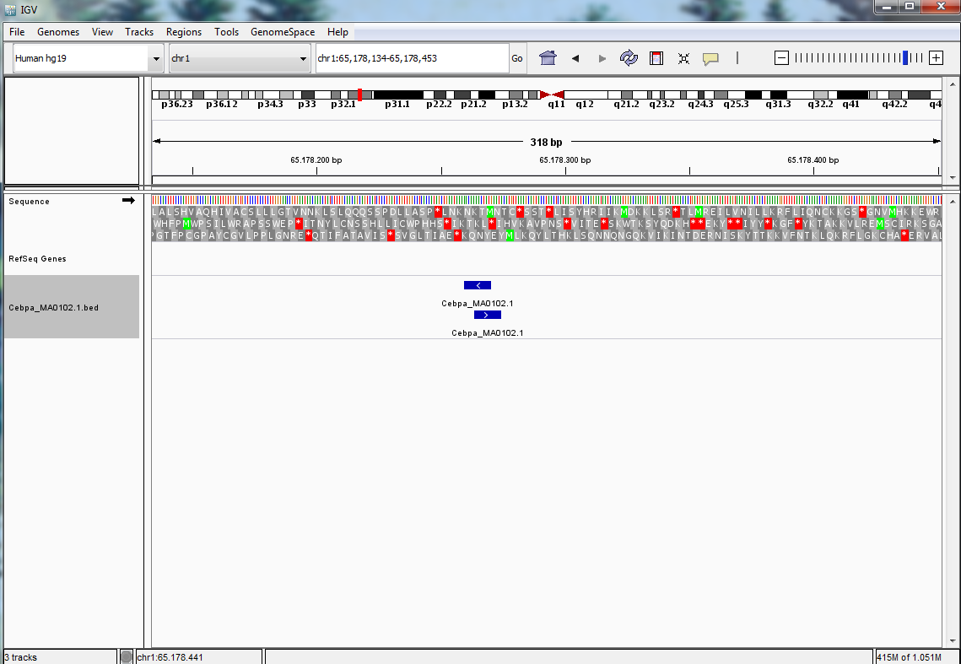
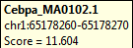
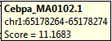
TFBS Scan Output IGV
11.604 > 11.1683
--resolve_overlaps
Notes:
After looking on the found information within IGV we have found out, that there are sometimes several TF that overlap each other. I have decided to use the score to look for the TF that we are really interested in. The higher the score is, the better the found TF is.
Using the optional argument --resolve_overlaps the user can choose to delete the overlaps

Slide 19
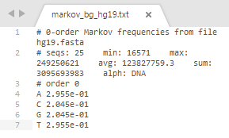
Customize TFBS Scan
-o [dir]: choose the output directory
-b [file]: .bed file with peaks
--use [fimo/moods]: choose the tool to use (by default fimo)
--clean [nothing, all …]: choose which files to delete after the run (by default all)
--cores [10]: choose how much cores you want to use (by default 2)
-p [0.0001]: choose p value (by default 0.0001)
--resolve_overlaps: delete the overlaps with smaller score (by default delete nothing)
--hide_info: make the run silent, the information will still be written to the log-file (by default print to the terminal)
--moods_bg 0.0 0.0 0.0 0.0: set the background to use with moods (by default 0.25 0.25 0.25 0.25)
--fimo „option“: pass the option to fimo, for example, set the background file (make the background file for fimo using fasta-get-markov from MEME Suite)
Notes:
Here are the options to customize the run of TFBS scan. I have used them while testing to find the best options. I will show you the results of the analyse I have done.
Here is an example of markov_bg that I have received

Slide 20
To analyse the TFBS scan I have used:
54 motifs
hg19.fasta
buenrostro_union.bed file with peaks
different parameters
Notes:
I have done several runs of TFBS scan with different parameters and compared the results with the chipseq data. I have tested my programm using 54 motifs from the buenrostro analysis. As a sequence file i have used hg19.fasta and as a file with peaks buenrostro_union.bed. For the background file i have taken the file made by the fasta-get-markov. As chipseq data I have used the files from PaperInPrep/TOBIAS/buenrostro_analysis/chipseq_GM12878_hg19/peaks
The bg for fimo can be set up due to parsing the bg-file. The user should provide this file. The bg-file can be easily made calling the fasta-get-markov from the MEME Suite package. The resulted file is a text file with the weights for A, G, C and T.
The bg for moods can be set up within my program as a additional parameter --moods_bg and it should look like a tuple (0.25 0.25 0.25 0.25). I have tried also setting the bg using the function provided by the MOODS calling MOODS.tools.flat_bg(), but it has not provided nice results.

Slide 21
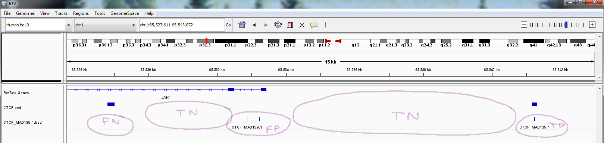
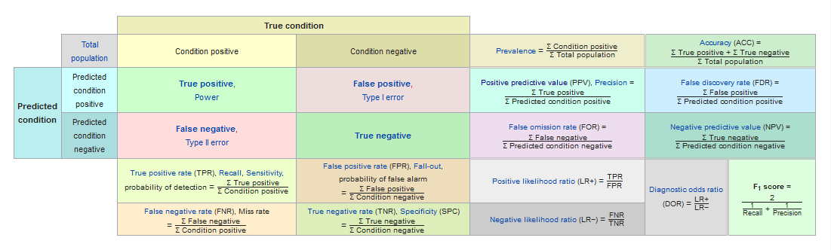
Analyse of TFBS scan
chipseq
TFBS scan
Image source: https://en.wikipedia.org/wiki/F1_score
Notes:
To analyse the TFBS scan results, Mette proposed to use the data from the ChipSeq analyse, as we see these information as truth, because the ChipSeq shows where the proteins have really bound.
(see https://ccg.vital-it.ch/chipseq/doc/chipseq_tutorial_intro.php)
The upper image shows how we decided what results are true positive, true negative, false positive and false negative. (actually we could not find the number of tn)
To measure the accuracy of TFBS scan we have decided to use several values. The first one was the sensitivity (proportion of positives that are correctly identified as such), after this I have measured the precision (positive predictive value) and finally the F1-score. My aim is of course to find which number of reads did i classify correctly.
I have done several runs of TFBS scan with different parameters and compared the results with the chipseq data. I have tested my programm using 54 motifs from the buenrostro analysis. As a sequence file i have used hg19.fasta and as a file with peaks buenrostro_union.bed. For the background file i have taken the file made by the fasta-get-markov. As chipseq data I have used the files from PaperInPrep/TOBIAS/buenrostro_analysis/chipseq_GM12878_hg19/peaks
The bg for fimo can be set up due to parsing the bg-file. The user should provide this file. The bg-file can be easily made calling the fasta-get-markov from the MEME Suite package. The resulted file is a text file with the weights for A, G, C and T.
The bg for moods can be setted up within my program as a additional parameter --moods_bg and it should look like a tuple (0.25 0.25 0.25 0.25). I have tried also setting the bg using the function provided by the MOODS calling MOODS.tools.flat_bg(), but it has not provided nice results.

Slide 22
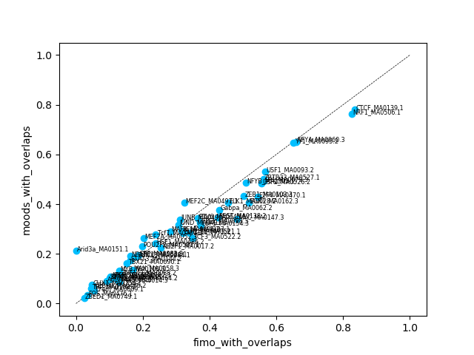
Sensitivity of TFBS scan
Notes:
So I have made plots to compare the conditions.
Mention that there are always several motifs, that situated nearer to 1.0 (such as CTCF_MA0139.1) and those situated nearer to 0.0 (such as Arid3a_MA0151.1). This is because of the length of them. The longer the motif is, the simplier they are to find. The length of Arid3a is only 6, while the length of CTCF is 19. That was our first conclusion.
Here are, for example, the comparison of fimo and moods with overlaps; comparison of fimo without overlaps and fimo without overlaps, but with the bg; or comparison in usage of moods with different p values.
Of course I have also made the comparison within the motifs, so that one can easily see what happens while setting different parameters.
On the first plot with blue bars you see the smaller (and stricter) the p value is, the less there will be found in TFBS scan. And the other way around. On the next plot you see the similar results performing with moods.
Finally I have count the mean for each run to know what conditions were the best. And you can see as expected, the higher sensitivity performs by the lowest p value, because there are much more reads found.

Slide 23
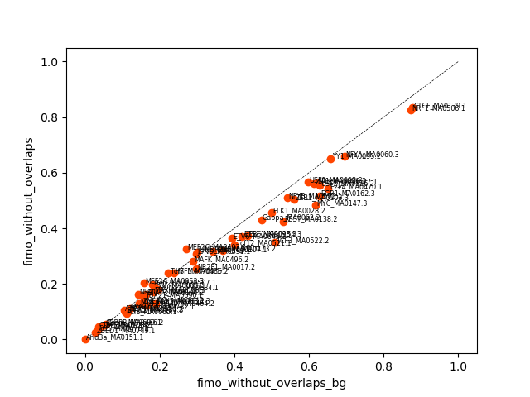
Sensitivity of TFBS scan
Notes:
So I have made plots to compare the conditions.
Mention that there are always several motifs, that situated nearer to 1.0 (such as CTCF_MA0139.1) and those situated nearer to 0.0 (such as Arid3a_MA0151.1). This is because of the length of them. The longer the motif is, the simplier they are to find. The length of Arid3a is only 6, while the length of CTCF is 19. That was our first conclusion.
Here are, for example, the comparison of fimo and moods with overlaps; comparison of fimo without overlaps and fimo without overlaps, but with the bg; or comparison in usage of moods with different p values.
Of course I have also made the comparison within the motifs, so that one can easily see what happens while setting different parameters.
On the first plot with blue bars you see the smaller (and stricter) the p value is, the less there will be found in TFBS scan. And the other way around. On the next plot you see the similar results performing with moods.
Finally I have count the mean for each run to know what conditions were the best. And you can see as expected, the higher sensitivity performs by the lowest p value, because there are much more reads found.

Slide 24
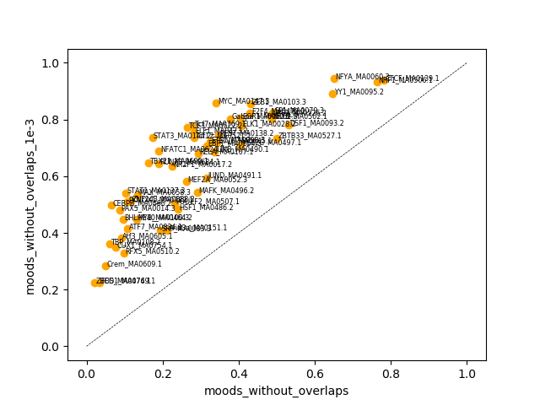
Sensitivity of TFBS scan
Notes:
So I have made plots to compare the conditions.
Mention that there are always several motifs, that situated nearer to 1.0 (such as CTCF_MA0139.1) and those situated nearer to 0.0 (such as Arid3a_MA0151.1). This is because of the length of them. The longer the motif is, the simplier they are to find. The length of Arid3a is only 6, while the length of CTCF is 19. That was our first conclusion.
Here are, for example, the comparison of fimo and moods with overlaps; comparison of fimo without overlaps and fimo without overlaps, but with the bg; or comparison in usage of moods with different p values.
Of course I have also made the comparison within the motifs, so that one can easily see what happens while setting different parameters.
On the first plot with blue bars you see the smaller (and stricter) the p value is, the less there will be found in TFBS scan. And the other way around. On the next plot you see the similar results performing with moods.
Finally I have count the mean for each run to know what conditions were the best. And you can see as expected, the higher sensitivity performs by the lowest p value, because there are much more reads found.

Slide 25
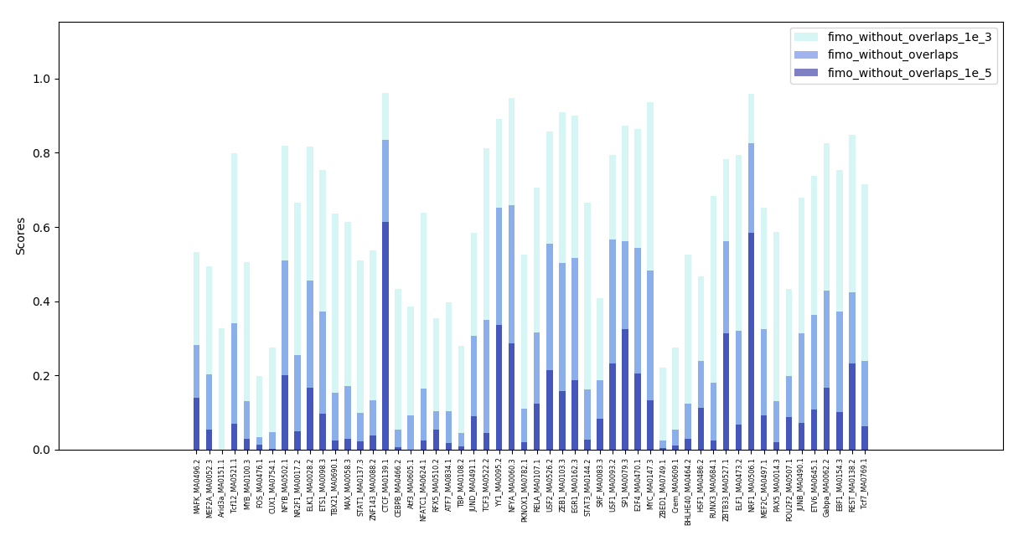
Sensitivity of TFBS scan
Notes:
So I have made plots to compare the conditions.
Mention that there are always several motifs, that situated nearer to 1.0 (such as CTCF_MA0139.1) and those situated nearer to 0.0 (such as Arid3a_MA0151.1). This is because of the length of them. The longer the motif is, the simplier they are to find. The length of Arid3a is only 6, while the length of CTCF is 19. That was our first conclusion.
Here are, for example, the comparison of fimo and moods with overlaps; comparison of fimo without overlaps and fimo without overlaps, but with the bg; or comparison in usage of moods with different p values.
Of course I have also made the comparison within the motifs, so that one can easily see what happens while setting different parameters.
On the first plot with blue bars you see the smaller (and stricter) the p value is, the less there will be found in TFBS scan. And the other way around. On the next plot you see the similar results performing with moods.
Finally I have count the mean for each run to know what conditions were the best. And you can see as expected, the higher sensitivity performs by the lowest p value, because there are much more reads found.

Slide 26
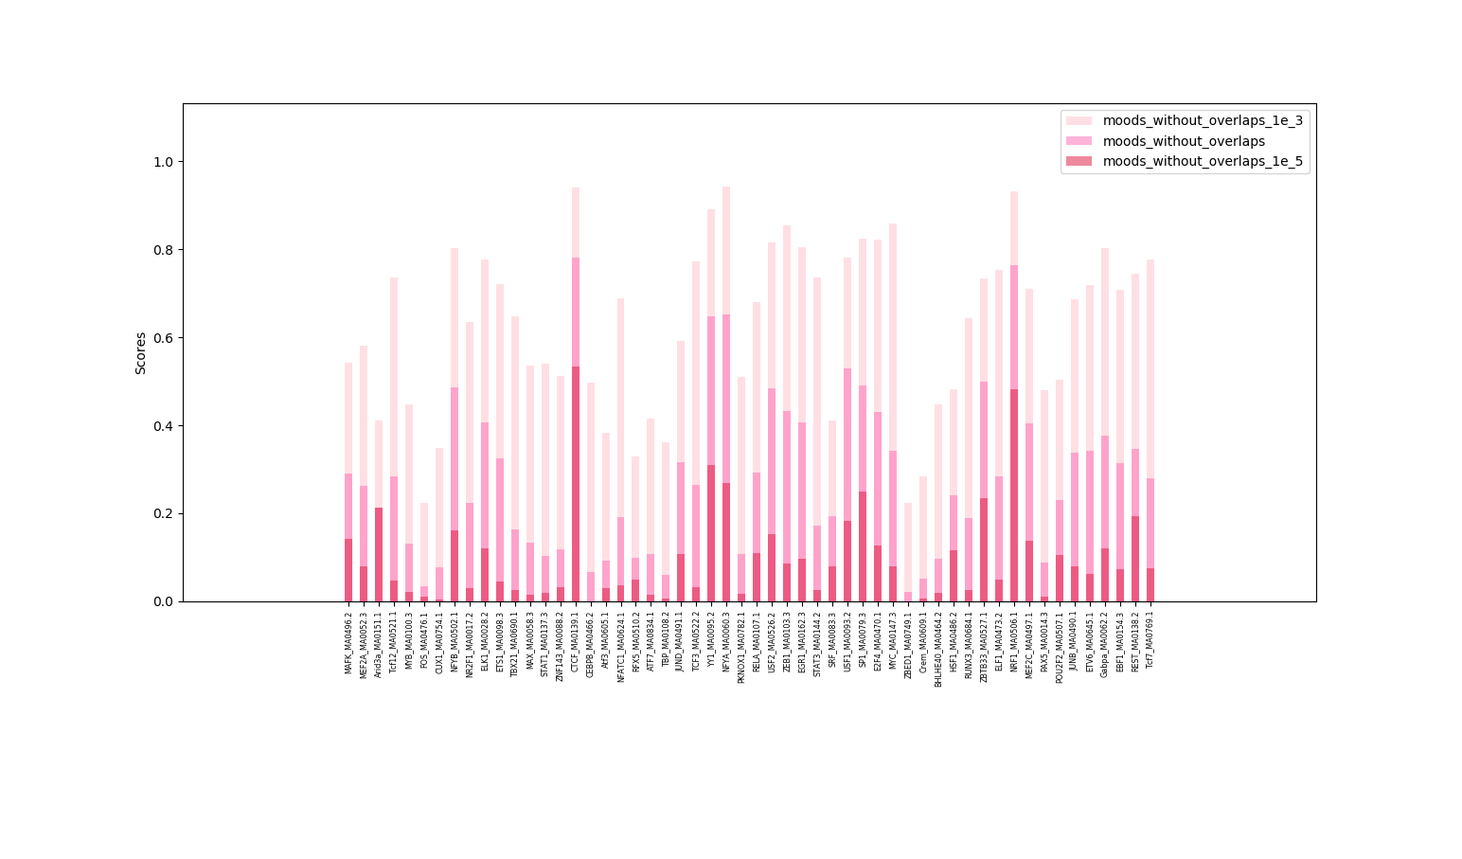
Sensitivity of TFBS scan
Notes:
So I have made plots to compare the conditions.
Mention that there are always several motifs, that situated nearer to 1.0 (such as CTCF_MA0139.1) and those situated nearer to 0.0 (such as Arid3a_MA0151.1). This is because of the length of them. The longer the motif is, the simplier they are to find. The length of Arid3a is only 6, while the length of CTCF is 19. That was our first conclusion.
Here are, for example, the comparison of fimo and moods with overlaps; comparison of fimo without overlaps and fimo without overlaps, but with the bg; or comparison in usage of moods with different p values.
Of course I have also made the comparison within the motifs, so that one can easily see what happens while setting different parameters.
On the first plot with blue bars you see the smaller (and stricter) the p value is, the less there will be found in TFBS scan. And the other way around. On the next plot you see the similar results performing with moods.
Finally I have count the mean for each run to know what conditions were the best. And you can see as expected, the higher sensitivity performs by the lowest p value, because there are much more reads found.

Slide 27
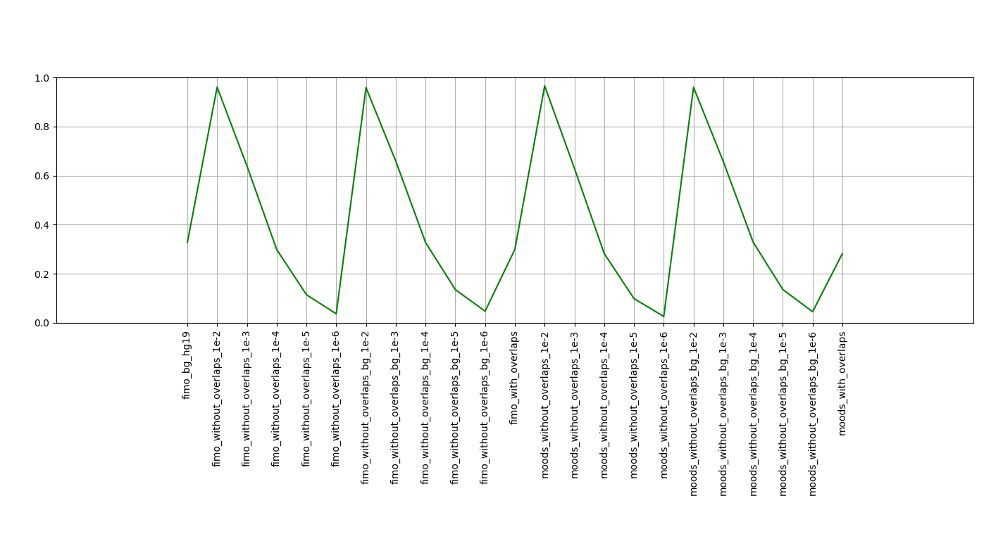
Sensitivity of TFBS scan
Notes:
So I have made plots to compare the conditions.
Mention that there are always several motifs, that situated nearer to 1.0 (such as CTCF_MA0139.1) and those situated nearer to 0.0 (such as Arid3a_MA0151.1). This is because of the length of them. The longer the motif is, the simplier they are to find. The length of Arid3a is only 6, while the length of CTCF is 19. That was our first conclusion.
Here are, for example, the comparison of fimo and moods with overlaps; comparison of fimo without overlaps and fimo without overlaps, but with the bg; or comparison in usage of moods with different p values.
Of course I have also made the comparison within the motifs, so that one can easily see what happens while setting different parameters.
On the first plot with blue bars you see the smaller (and stricter) the p value is, the less there will be found in TFBS scan. And the other way around. On the next plot you see the similar results performing with moods.
Finally I have count the mean for each run to know what conditions were the best. And you can see as expected, the higher sensitivity performs by the lowest p value, because there are much more reads found.

Slide 28
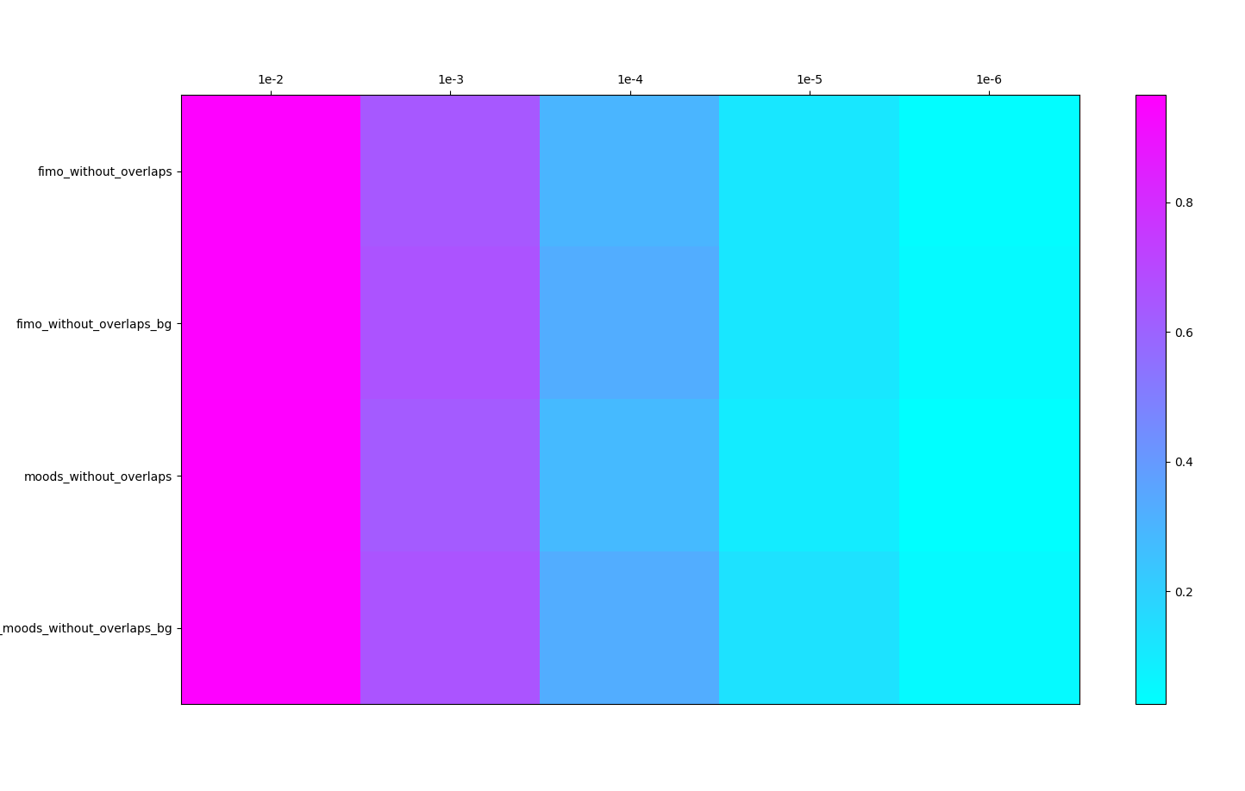
Sensitivity of TFBS scan
Notes:
So I have made plots to compare the conditions.
Mention that there are always several motifs, that situated nearer to 1.0 (such as CTCF_MA0139.1) and those situated nearer to 0.0 (such as Arid3a_MA0151.1). This is because of the length of them. The longer the motif is, the simplier they are to find. The length of Arid3a is only 6, while the length of CTCF is 19. That was our first conclusion.
Here are, for example, the comparison of fimo and moods with overlaps; comparison of fimo without overlaps and fimo without overlaps, but with the bg; or comparison in usage of moods with different p values.
Of course I have also made the comparison within the motifs, so that one can easily see what happens while setting different parameters.
On the first plot with blue bars you see the smaller (and stricter) the p value is, the less there will be found in TFBS scan. And the other way around. On the next plot you see the similar results performing with moods.
Finally I have count the mean for each run to know what conditions were the best. And you can see as expected, the higher sensitivity performs by the lowest p value, because there are much more reads found.

Slide 29
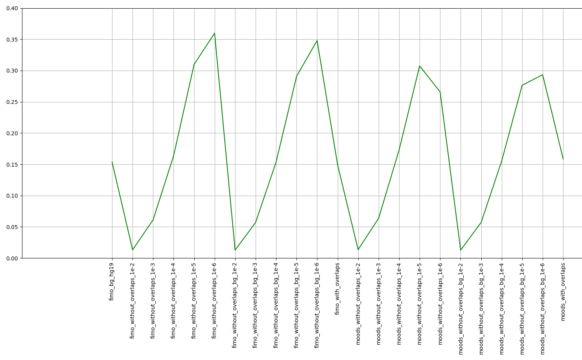
Precision of TFBS scan
Notes:
The precision (positive predictive value) shows of course the better results with stricter p value

Slide 30
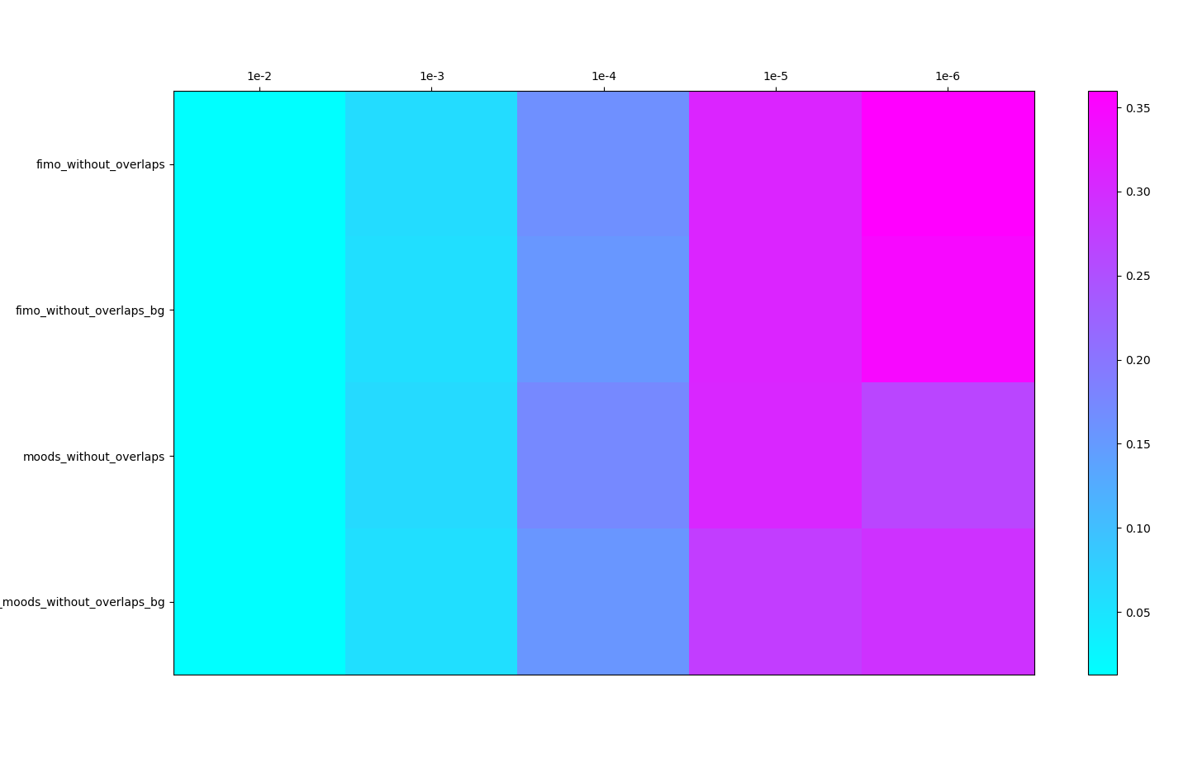
Precision of TFBS scan
Notes:
The precision (positive predictive value) shows of course the better results with stricter p value

Slide 31
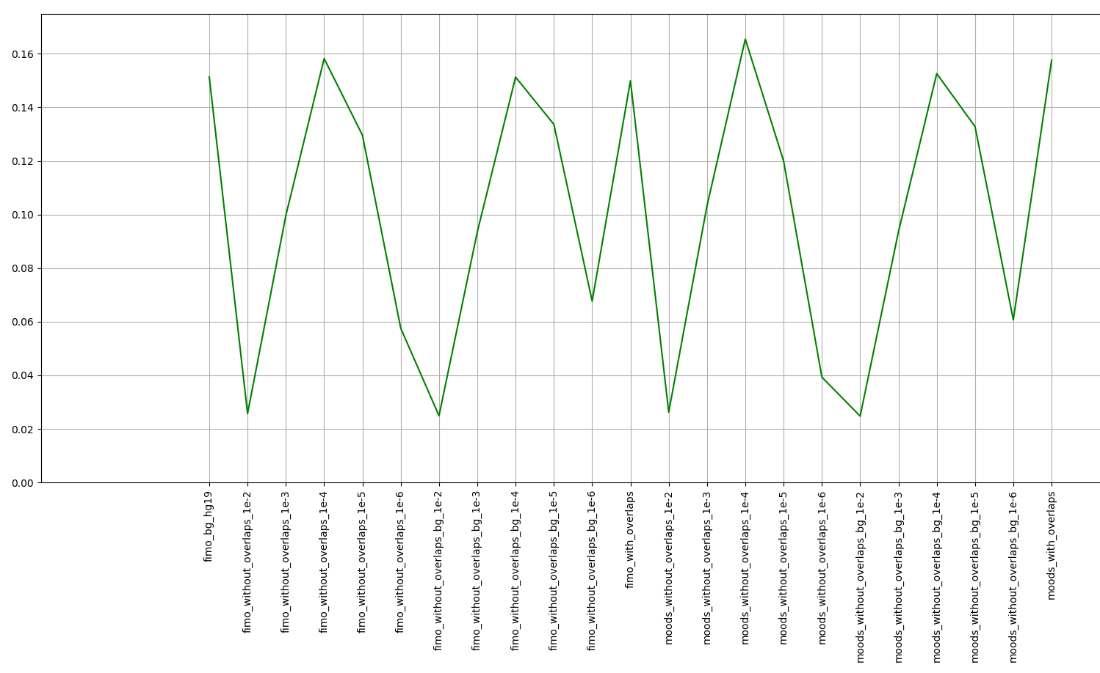
F1-Score of TFBS scan
Notes:
The F1-score is the harmonic mean of precision and recall, so we are tending to use it as the best measure for accuracy of TFBS scan.
The best results are achieved using the standard p value and resolving the overlaps in moods, the fimo with standard p value and resolving overlaps produces a little bit worse results.
Using the background for moods produces worse results than the moods without background.

Slide 32
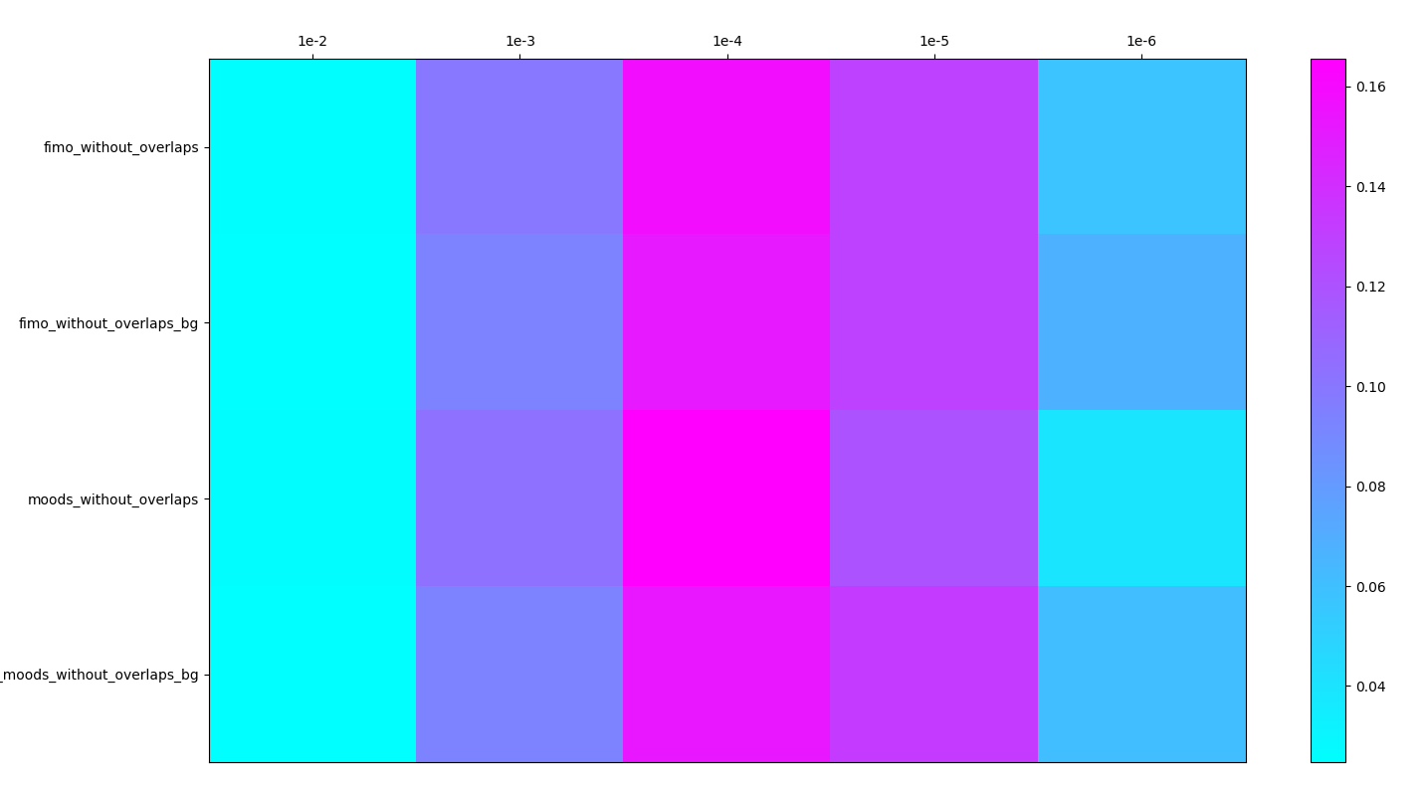
F1-Score of TFBS scan

Slide 33


